Slide 1
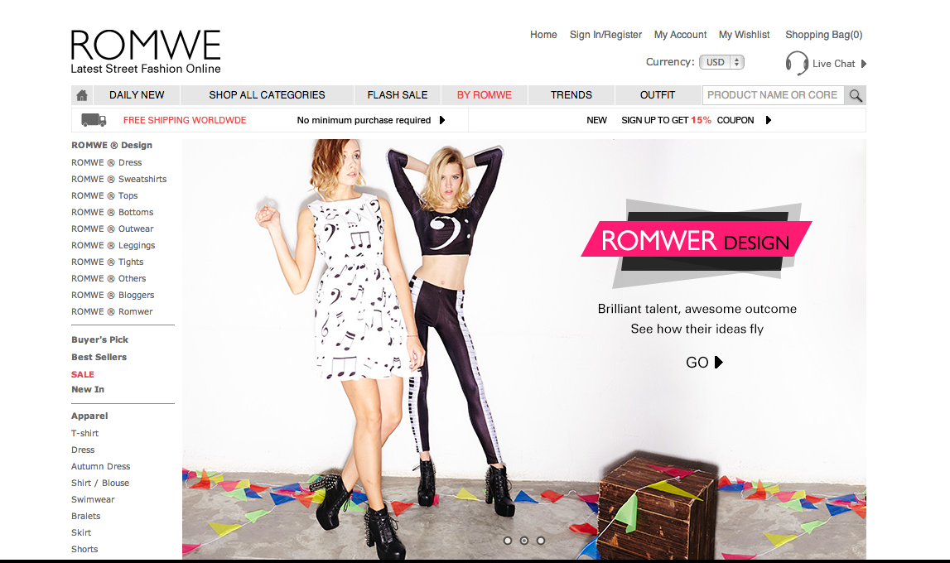
MARKETING WEB ANALYTICS PROJECT

Slide 2
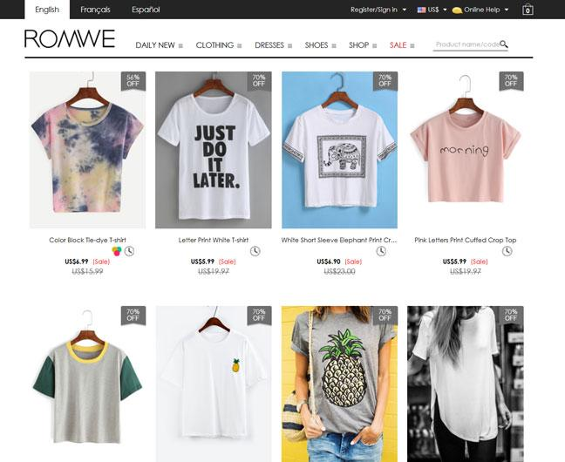
ABOUT US
Romwe is global fast fashion e-commerce platform mainly focused on women’s apparel, event dresses and jewelry found in 2010
Romwe delivers their goods from Europe, US, China to nearly every country in this world
Romwe follows a B2C business model
Romwe has 1.6M followers on instagram, 4.2M followers on Facebook and 40K followers on twitter
Romwe launched Plus size, home and living assortments in 2018

Slide 3
KEY BUSINESS OBJECTIVES
Increase in profits by converting the visitors into customers which can increase the revenue of the company
Record the attributes of the products which are sold the most for better understanding of customer needs and their future satisfaction
Record different sources of customer traffic to target the customers through the most optimum channel

Slide 4
Revenue, Sessions, AOV
Customer Retention
Conversion Rate
Traffic Source
Shopping Cart Abandonment Rate
Customer Lifetime Value Analysis
Source Region
Bounce Rate
KEY PERFORMANCE INDICATORS

Slide 5
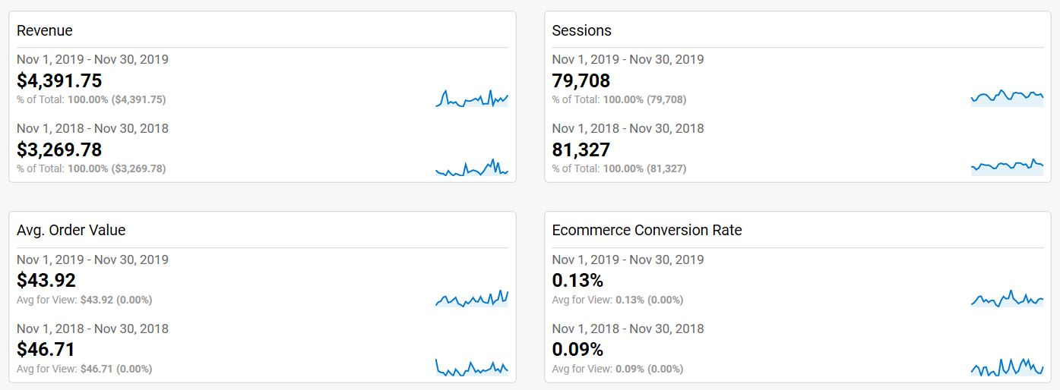
BLACK FRIDAY MONTH SALES

Slide 6
REVENUE WATERFALL ANALYSIS
ON
BLACK FRIDAY MONTH SALES:
2019 vs 2018
 | LY | TY | % vs LY | # vs LY | Metric Change Impact on Revenue
REVENUE | $ 3270 | $4392 | 34% | $1122
SESSIONS | 81327 | 79708 | -2% | 1619 | $ (68)
AOV | $47 | $44 | -6% | $2.79 | $ (204)
CONVERSION | 0.09% | 0.13% | 44% | 0.04% | $ 1520

Slide 7
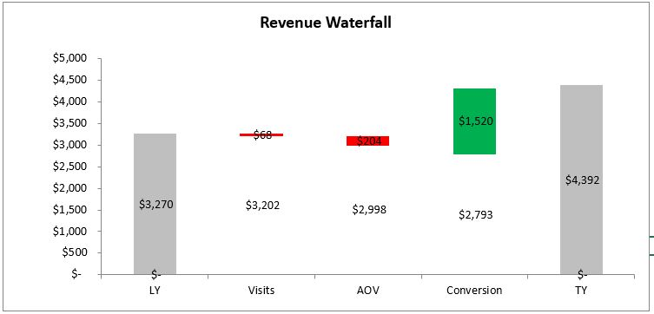
From the Waterfall Chart we can see the the revenue generated Last Year for the month of November was $3270, while This Year it was $4392.
There was a drop in No of Visits causing a revenue loss of $68 for This Year.
Also, Average Order Value also decreased causing a revenue impact of -$204 for This Year.
However, the Conversion Rate of This Year was quite high, causing a positive impact of $1520 , thus increasing the overall revenue for This Year compared to Last Year.

Slide 8
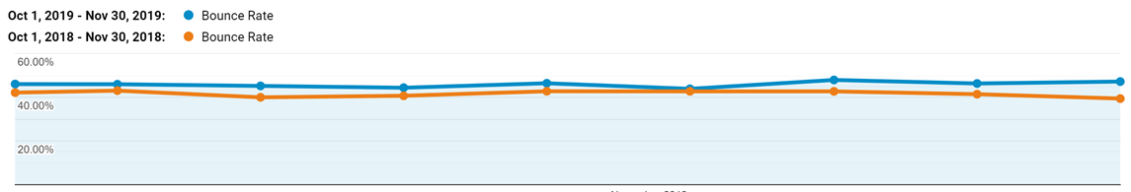
BOUNCE RATE
A high BR means customers visiting the site are not finding what they’re looking for which leaves them with no interaction with the site.
BR is higher for 2019 compared to that of 2018 but average Bounce Rates for both the years are between 40 - 60%. Romwe needs to focus on bringing this around 30 % which is the ideal range to be in.

Slide 9
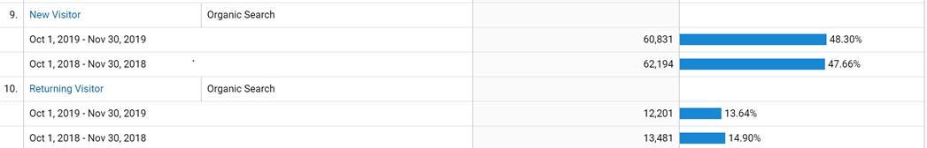
BOUNCE RATE
Bounce rate is decreased for returning visitors but increased for new visitors. so we have to make our website more user friendly for new visitors
The site needs to be optimized in a way to engage new users. An exciting offer like free shipping, a promo code or a discount for new users could be a few ways to ensure new users spend longer on the website.

Slide 10
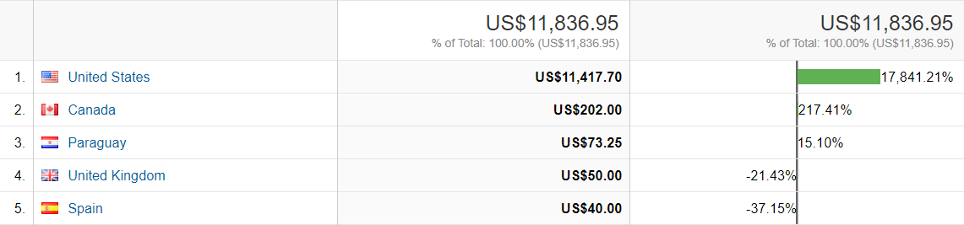
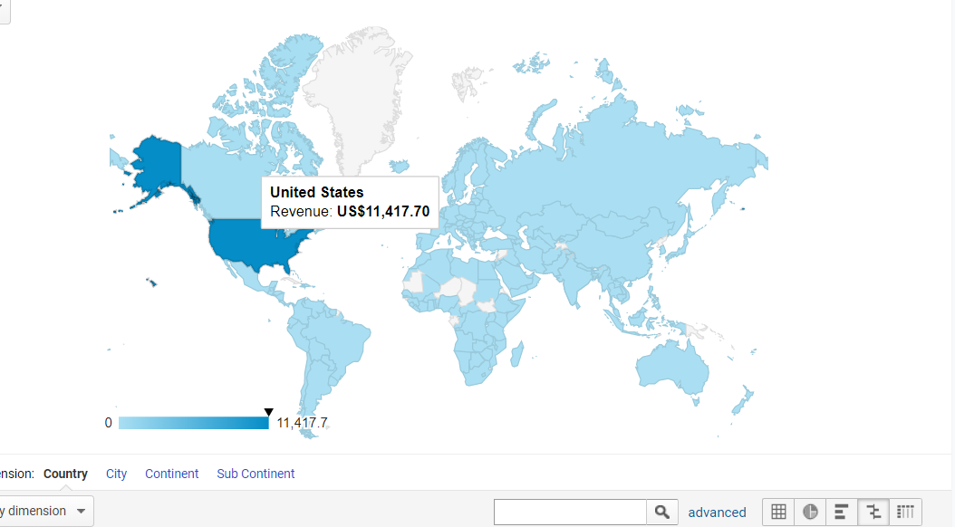
Region Analysis
Top 5 Countries with highest revenue
For the months of October 2019 and November 2019, the United States has contributed the highest revenue.
The revenue generated by the United States for these two months was US$11,417.70.
We can also see that United States dominates all other countries with a whopping 96.5% contribution to the total revenues.
Notes:
One of most important aspect which we need to take into consideration while targeting our potential customers is the Region.
Where are most of the customers situated? which region generates the highest revenue? which region has the highest active customers?
The answers to these questions can be very useful if we think from an e-commerce point of view!
In this slide we can see the top 5 countries generating the highest revenue for the month of october'19 and nov'19 with United States at the top. The revenue generated by the US contributes 96.5%
to the total revenue which is US$11,417.70.

Slide 11
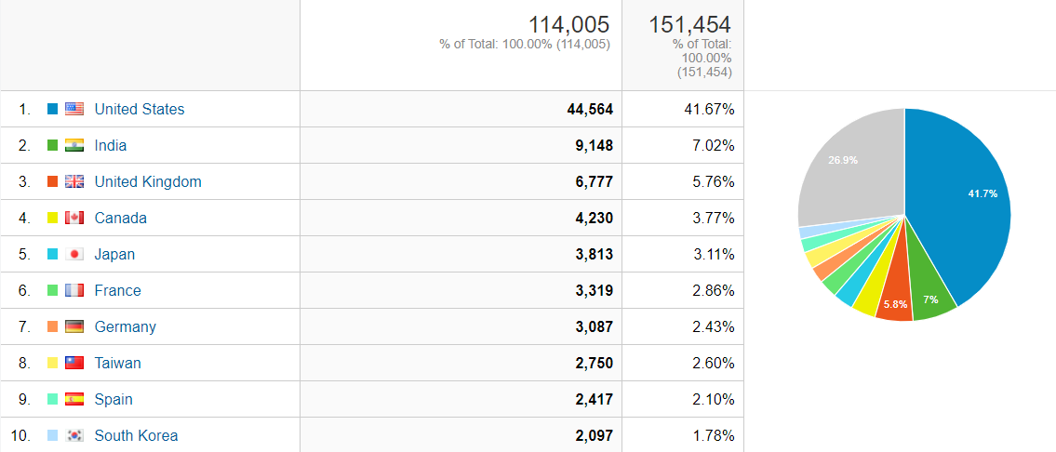
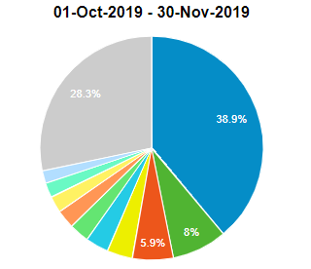
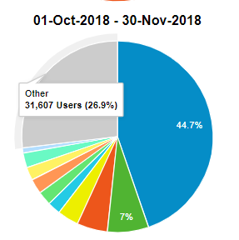
Despite having 41.7% Active users, The US still contributes 96.5% to the total revenues
Where as countries like india which has the second highest active users following the US has 0% contribution to the total revenues
The United States is the only country which has shown a decrease in the number of active users from LY to TY
Other countries which have very less contribution to the revenue shows a significant increase in its active since the LY
There has been an overall decrease in the active users from LY to TY
Change in the number of active users from 2018 to 2019
Notes:
With this strong dominance we can handsdown say that it is a great idea to expand our market in the US as compared to other countries.
In this slide we can see that US has the highest percentage of active users which accounts for its such high revenue. The interesting part is that despite having less that 50% active users,
The US still manages to generate a whopping amount of revenue.
Looking at the analysis, we can aslo say that India might not be a good option to expand our business sice they do not generate revenue at all!
We also see that United states have a decrease in their active users this year from the Last year! We might want to dig deeper as to why US has a declined in its active users since it is our major source of revenue.
Focusing on the right region with right product can definitely help us increase our profits!!!

Slide 12
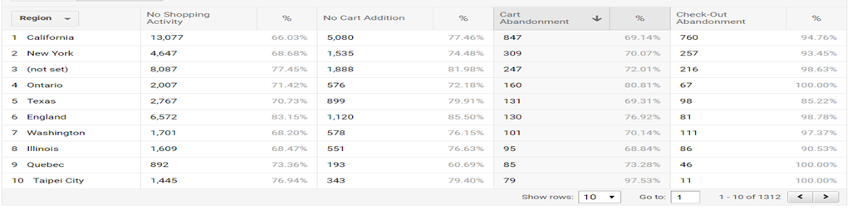
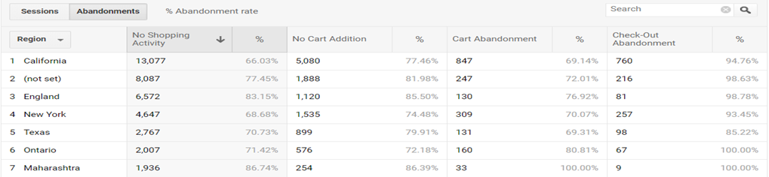
Shopping Cart Abandonment Rate -By Region
Shopping Cart Abandonment Rate Formula: % of (1- [# of completed purchases/# of shopping carts created).
The highest shopping cart abandonment by volume is from customers in California with over 847 carts being abandoned.
The region with the highest overall shopping cart abandonment rate is Maharashtra, India with a 100%.
Notes:
This slide provides a detailed analysis on the shopping cart abandonment rate analysis by region. The shopping cart abandoment rate is quite simply, the percentage rate that helps online retailers identify the number of people who intended to make a transaction but did not complete the purchase or were lost before purchase completion. The highest cart abandonment by volume is from customers in California with over 847carts and the highest overall shopping cart abandonment rate is from users in Maharashtra, India with a notorious 100%.A hypothesis testing on the usite using A/B testing can be done with the hypothesis being why visitors are abandoning shopping carts. This may create a path to make site changes according to the results to lower the shopping cart abandonment rate, increase online sales and grow the customer base.

Slide 13
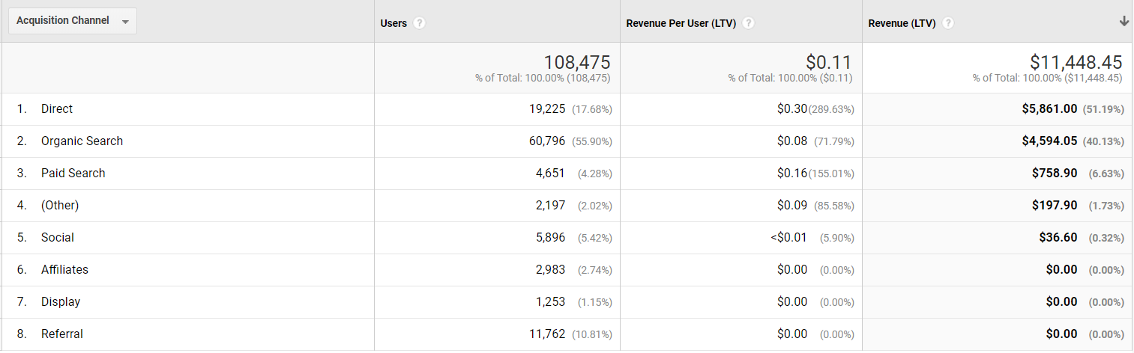
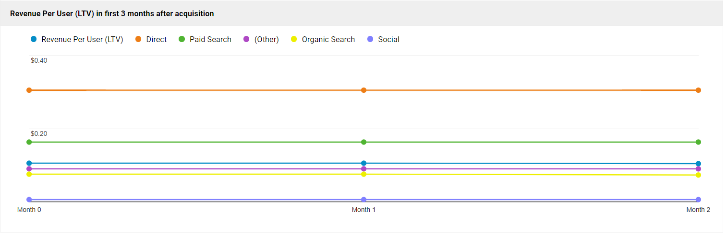
Customer Lifetime Value by Acquisition Channel Analysis
According to statistics presented by Gartner, 80% of a company’s future revenue will come from just 20% of existing customers.
Formula for measuring Customer Lifetime Value : Customer revenue - the costs of acquiring and serving the customer
The top 5 channels with the highest revenue per customer lifetime value are: Direct,Paid Search, Other channels,Organic Search and Social.
Direct Search having the highest Revenue per Lifetime Value percentage with over 51%, indicates a strong loyalty with respect to existing customers.
Notes:
The next slide provides an analysis based on another significant KPI, the customer lifetime value.It represents the total amount of money a customer is expected to spend in your business, or on your products, during their lifetime. This is an important figure to know because it helps you make decisions about how much money to invest in acquiring new customers and retaining existing ones.The direct search channel and organic search channel are bringing in the highest revenue based on customer lifetime value, which is a positive sign, wheras affiliates, display and Referral are not as effective.

Slide 14
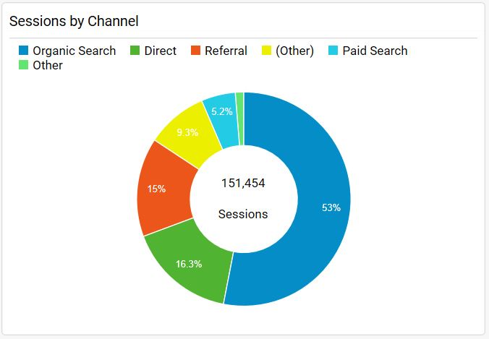
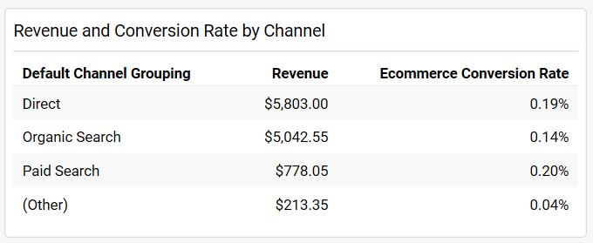
Sessions, Revenue, Conversion rate by Marketing Channel
For the month of Oct-Nov 2019, we can see that most of the revenue generated is via Direct search or Organic search. 53% of the sessions to the website are through Organic search. This shows that our website has relevant keywords in it which the customers are searching for.
However, the conversion rate for it is only 0.14%. Although we are getting visits from customers, its conversion rate is not good.
On the other hand, revenue generated via Paid search(5.2%) is less but its conversion rate is highest which is about 0.20%.

Slide 15
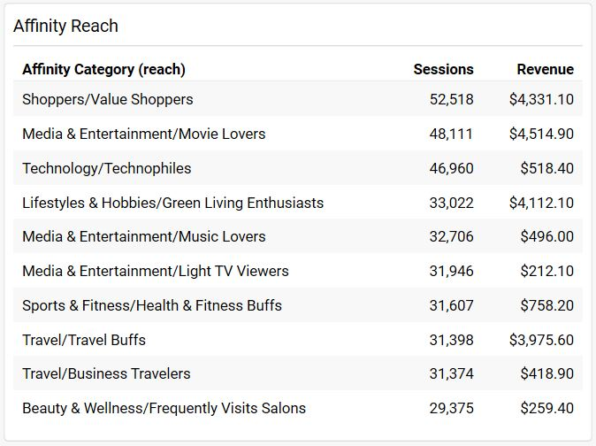
Affinity Reach
Affinity categories are mostly used to reach potential customers.
On analysis over Affinity Reach, we can see that most of the customers belong to the category of Shoppers, Entertainments Lovers, Travelers or Fitness Buffs.
Revenue generated from categories - Shoppers and Entertainment Lovers is good relative to revenue generated from customers belonging to - Business Travel or Sports categories. Although we have visits but the conversion is not good for some categories.

Slide 16
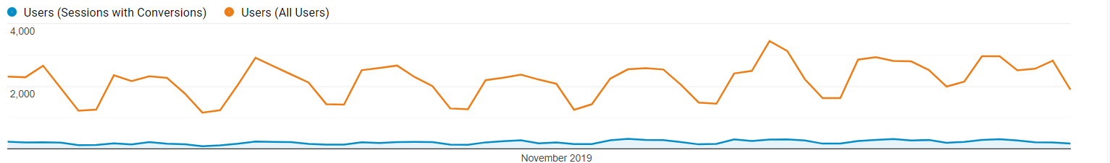
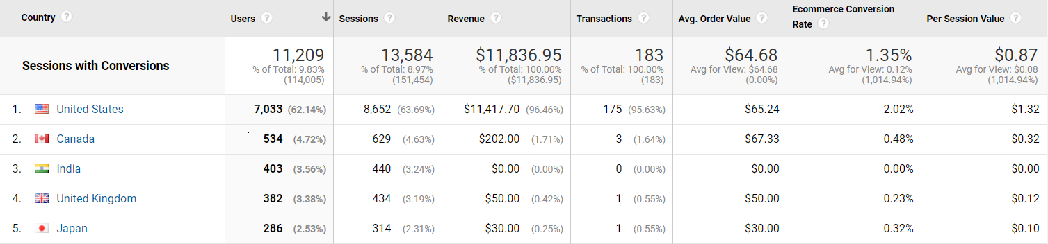
Conversion Rate
jdskncdjs
These charts depict the Conversion Rate from October 2019 - November 2019 . Despite having visitors in the range of 2000 to 4000 everyday, the Conversion Rate of 9.83 is very low.
United States is not only the largest contributor to the Revenue for this period, it also has the highest Ecommerce Conversion Rate and Per Session Value.
Notes:
Our last KPI is Ecommerce Conversion Rate. It is the percentage of visits that resulted in an e-commerce transaction and is calculated as the ratio of transactions to visits expressed in
the form of a percentage. It is one the most important KPI for an Ecommerce business and is a good indicator of success or failure. These charts show that the Ecommerce Conversion Rate for the period
October 2019 and November 2019 is just 1.35% indicating that though 2000 to 4000 users are visiting the site, there just aren't enough happy customers placing orders. We have already discussed how United States is a primary market and the chart 2 shows
more statistics in terms of Transation, Average Order per Value, Per Session Value. We can see that US has the best numbers in majority of the category but it is interesting to note that
Japan has a better Average Order per Value indicating that the average dollar amount spent each time a customer places an order is higher for Japan. Online recommendation systems,
offering customized discounts and losing shipping costs could be a great way to boost the Conversion Rate.

Slide 17
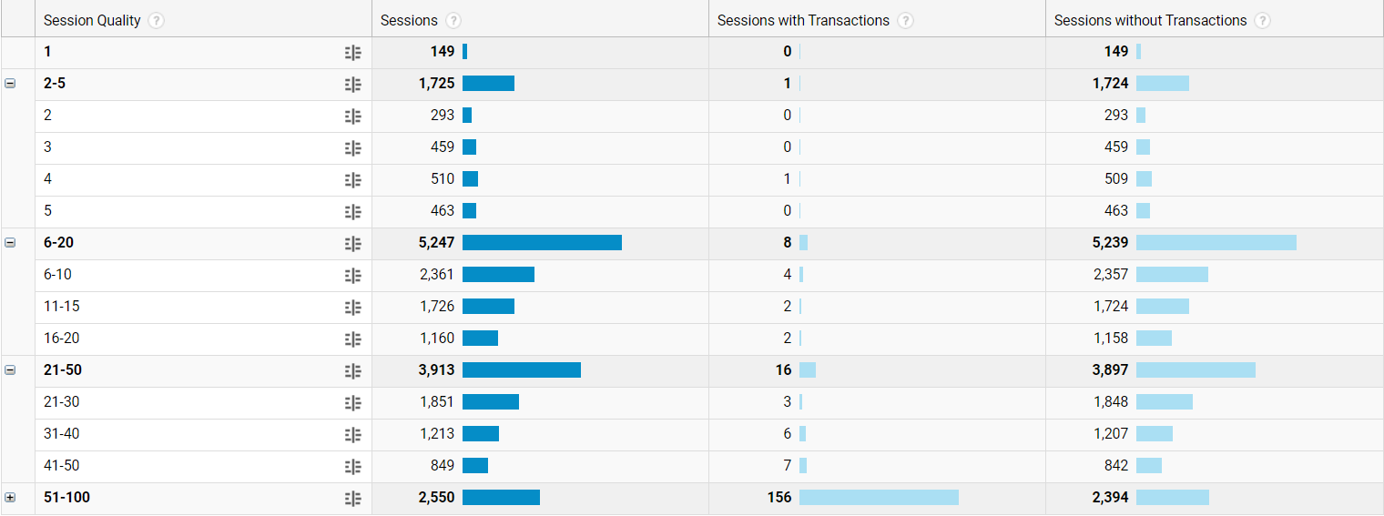
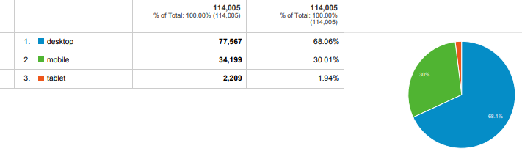
Higher quality sessions (51-100) shows better Conversion Rate(156). Whereas, the total rate is just 25 for sessions with low quality. Thus, we can conclude that Conversion Rate improves with session quality.
68.06% of Sessions with transactions occur on Desktops while Tablets are least preferred by Users.
This indicates that User prefer to view product details on a bigger screen.
Notes:
This slide explores the effect of Session Quality and Mobile Device Type on the business of our site. Through our analysis, we found a direct corelation between the quality of session and
transactions. Majority of the transactions were made when the user was provided with a good quality session, whereas user didn't show much interest in making purchases when they faced issues
with the website. This is reflected in the Session Quality Chart which shows that 156 transactions were made when the quality of session was above 50 as opposed to only 24 transactions that
occured when the session quality was below 50. On occasion like Black Friday, there is a huge influx of Visits and it's important to have a website that can smoothly handle this bandwidth without breaking down midway
and causing loss of Revenue.
Amongst the Mobile Device Type, Desktop is highly favourable since it gives the users a chance to view the product images on a bigger display. With roughly 68% transactions being made on
Desktop, we should be careful while designing our webpages. Small knacks like investing in a good camera and photographer, uploading the best quality images, using white background, having
a user friendly interface can make a huge difference.
Mobile Phones have the second best figure of 30% which is a very significant number. Factors like easy accesibilty, social media access and various message notifications being sent to
excite Users play a major role in this figure. Keeping this in mind, we need to ensure that the marketing is optimized for those viewing it on a Desktop and a Mobile Phone.

Slide 18
Recommendations!!!
Focus more on Paid search.
Discount offers or gift value coupons.
Rational different channel with increased budget.
Open our new sub-branch of romwe in USA
Offering customized discounts leads to a higher Conversion Rate.
Follow up with users via email can boost the Conversion Rate.
Creating Product videos to seek User’s attention.
Identifying the problem pages with the highest bounce rates.
Attracting titles like “Easy Returns”, “Hassle-Free Exchange”.
Sales for “Online Only”.
Notes:
Focus more on Paid search by targeting audience based on Affinity.
As 53% of our audience was through Organic search, we can say that our website has relevant keywords but less conversion rate. Thus, we should focus more on converting those visits by introducing some discount offers or gift value coupons.
Since channels like Affiliate, Display and Referral aren’t contributing much towards customer loyalty and retention, trying out a rationally different channel like email with increased budget may help diversify the spectrum.- Rational different channel with increased budget.
Since the maximum revenue is generated from the US, we can open our new sub-branch of romwe in USA, which can purely analyze different regions in the USA.
Online recommendation systems, offering customized discounts and losing shipping costs could lead to a higher Conversion Rate.
Quality of sessions should be improved to ensure that Users don’t quit a transaction midway. If a website is collecting emails during checkout, then following up with users via email can boost the Conversion Rate.
Since majority users make a purchase on Desktops, special attention should be paid on image qualities and product descriptions. Creating Product videos is another creative way to seek User’s attention.
Identifying the problem pages with the highest bounce rates and by ensuring the images, videos and terms optimized for the product category needs to be same as the searched term will help fix this problem as well.
Attracting titles like “Easy Returns”, “Hassle-Free Exchange” will urge customers to make a purchase online.
More sales for “Online Only” can be promoted to drive more traffic to the website.

